Slide 1
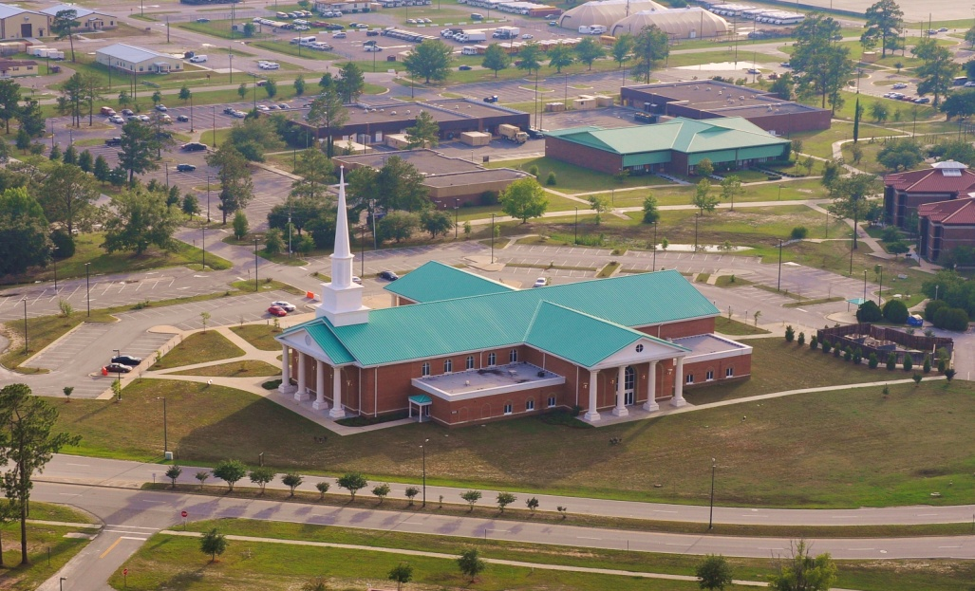
SENIOR CHAPLAIN IN-BRIEF
CH (MAJ) Dan Hardin
Installation Family Life Chaplain

Slide 2
Agenda
Mission
Definitions + Snapshots
Referral Process
Questions

Slide 3
Chaplain Family Life Ministry Center
Family Life Chaplain Mission
Primary: Train unit Chaplains in pastoral counseling skills. Provide Master’s-level pastoral counseling for individuals, couples, and families when appropriately referred by Chaplains, Behavioral Health, Social Work Services or other helping agencies.
Secondary: Operate the Chaplain Family Life Ministry Center in collaboration with the Division Family Life Chaplain. Serve as a subject matter expert on pastoral and clinical counseling issues as requested and coordinated. Provide “outside-the-chain-of-command” pastoral counseling pastoral psychotherapy for Chaplains, Chaplain Assistants, other helpers, and senior leaders.

Slide 4
Definitions
Family Life Chaplains: Family life ministry also provides highly specialized Family life Chaplains serving as advance degree credentialed Family systems therapists and trainers. Family life Chaplains are the credentialed primary trainers of Family life skills. Family Life Chaplains (FLCs) will support commanders by providing additional training to Chaplains in pastoral counseling and relationship education skills and programs. The SrCHs on installations and supervising Chaplains will ensure that the primary effort of FLCs is dedicated to these missions.
Source: AR165-1, 3 December 2009

Slide 5
Family Life Chaplain Snapshot
CH (MAJ) Dan Hardin – Installation Family Life Chaplain
Chaplain Hardin is a graduate of Columbus State University with a master’s degree in Community Counseling and Marriage and Family Therapy. He is a nationally certified counselor and licensed in the state of Georgia. Chaplain Hardin earned other degrees in pastoral theology and computer information systems. He has been in the military since 1987. He is married and has four children. Chaplain Hardin’s specialties are Couples Collaborative Therapy, Internal Family Systems Therapy, inner healing prayer, healing trauma and PTSD, marriage and family systems, and training. His interests include music, guitar, hiking, and photography.

Slide 6
Family Life Chaplain Snapshot
CH (MAJ) Tyson Wood– 3ID Family Life Chaplain
Chaplain Tyson Wood is a priest of the Roman Catholic Church and a graduate of Texas A&M (Central State) with a master's degree in Psychology. Additionally, he has earned graduate degrees in theology and in history. Chaplain Wood enlisted in the Army in 1985 and also has experience as an infantry officer prior to becoming a chaplain. He is one of the few married priests in the Catholic Church and has been married to his wife for twenty years; they have three children. Chaplain Wood's counseling specialties are Narrative Therapy and Emotionally Focused Couples Therapy. His interests include spending time with his family, studying history and physical fitness.

Slide 7
Definitions
Family Life Ministry: Family life ministry refers to a broad range of activities undertaken by all UMTs to enable Soldiers to build and maintain personal spiritual health and build or restore healthy relationships.
Family life ministry includes education, consultation, and pastoral counseling.
Family life education is preventive in nature and provides resources for Army constituents to develop healthy relationships on every level that are able to thrive under the pressures of military life. It may include education for single Soldiers, couples, Families, or extended Families, and training in a wide range of factors, such as finances, parenting, and deployment stress.
Consultation and pastoral counseling is a formal and spiritually integrated process enabling Army constituents to change, cope, and resolve their presenting issues in a religious framework.
Source: AR165-1, 3 December 2009

Slide 8
FLC Ministry Snapshot
Committees: | When: | Where: | POC: | Average Att.: | Notes:
Spiritual Resiliency Work Group (SRWG) | 2nd Tuesday0930-1130 | Main Post Chapel Room 108 | NA | 20 | Project Officer Plan and coordinate.
Suicide Prevention Task Force (SPTF) | 3rd Thursday 1300-1500 | Building One Executive Conference Room (ECR) | Deedra Hinton | 30-35 | No due outs.
Case Review Committee (CRC) | 1st and 3rd Tues. 0900-1500 | Social Work Services- New Outpatient Clinic near SWS | Ed Haback | 10 | No due outs. Voting member on orders.
Family Advocacy Committee | Monthly | Garrison Conference Room (GCR) | Patty Ayala | 20 | No due outs.
Sexual Assault Working Group | Monthly | ACS | Demika Jackson |  | No due outs.
Fatality Review Committee | Quarterly | GCR | Patty Ayala | 20 | No due outs.
Health Promotion Council | Quarterly | ECR | Sarah Carter | 50 | Project Officer- use outputs from SRWG.
FAMILY LIFE MINISTRY SNAPSHOT

Slide 9
FLC Ministry Snapshot
Programs: | When: | Where: | POC: | Average Att: | Notes:
Behavioral Health Review Committee | Monthly | Garrison Conf. Rm. | Patty Ayala | 10 | Provide professional opinions.
Marriage 101 | 2nd Tuesday 0900-1500 | Victory Chapel | NA | 10 | Provide food. Notarize certificates. Package for unit Chaplains as requested.
Strong Bonds Retreats | As requested | Varies | Unit Chaplain | Varies | Assist and train unit Chaplains.
Clinical Pastoral Psychotherapy & Psychoeducational Operations | Weekly, 20 Hours | Victory Chapel | NA
FAMILY LIFE MINISTRY SNAPSHOT

Slide 10
FLC Ministry Snapshot
Training: | When: | Where: | POC: | Average Att: | Notes:
Installation UMT Training (RSOT) | 2nd Thursday 0830-1200 | Main Post Chapel Activity Center | NA | 50-60 | Project Officer. Plan and coordinate. See training plan
CAO/CNO Grief Awareness Training | 2nd Tuesday 1400-1500 | Education building- room varies | Alan Caldwell | 30-40 | Discuss grief, notification experiences and respond to questions
Pastoral Skills Training (CPRT-PST) | 1st and 3rd Thursday of the Month 0900-1200 | Victory Chapel | NA | 5 | New chaplains must complete to qualify for C4
Group Contemplative Prayer & Lectio Divina | Mondays 1130-1300 | Victory Chapel | NA | 2 | Spiritual Mindfulness & Resiliency Training
FAMILY LIFE MINISTRY SNAPSHOT

Slide 11
Definitions
Chaplain Family Life Centers: The CFLCs will be staffed appropriately, at a minimum, 1 FLC,1 Chaplain Assistant (SSG), and / or 1 secretary / receptionist to ensure on-site service and safety. The FLCs will provide training and supervision for Chaplain Assistants assigned to CFLCs to ensure they have skills necessary to function in a CFLC. At a minimum, CFLCs will include a reception area, an office, counseling room, and equipment to enable the Chaplain to provide pastoral counseling and relationship education services, and to conduct Chaplain training.
Source: AR165-1, 3 December 2009

Slide 12
Family Life Center Snapshot
Facility :
Victory Chapel, Bldg 2125
4 Offices (Admin, Intake, Installation FLC, and Division FLC)
1 Reception area
All other areas shared with Club Beyond (i.e. Sanctuary, kitchen, other rooms
Renovation of back storage to classroom needed
New HVAC system with controls needed
Personnel:
1 TDA authorized and filled 56A7K Family Life Chaplain
1 56A7K Family Life Chaplain (3ID)
No TDA authorized enlisted or GS position
1 attached “Sanctuary” R/C 56M40 (SFC Anderson) waiting retirement (Sept 2012)
1 56M10 (SPC Downey) assigned 13 July 12

Slide 13
Family Life Center Snapshot
Inst. FLC Office
HVAC
Bath
VICTORY CHAPEL
BLDG 2125
Storage
Storage
Div FLC Office
Intake Forms
Courtyard
Sanctuary
Youth Office
FLC Admin
Reception / waiting area
Youth Game Room
Bath
Bath
Kitchen

Slide 14
Definitions
Family Life Training Levels: The Chaplaincy recognizes 3 skill levels of Family life training.
Basic pastoral counselor. Basic competence is established by completing CHBOLC and PST-FL or equivalent provided by a FLC or other professional.
Family Life Chaplains. Chaplains who complete the U.S. Army Family Life Chaplain Training Program or an equivalent program as determined by the CCH. FLC qualifying training includes a masters-level degree in counseling, a practicum in counseling, theological integration, and specialized training in military applications.
Family Life Chaplain supervisor. FLCs who have successfully completed the Family life supervisor in Training Program or an equivalent program, and who meet the professional credentialing requirements for Approved Supervisor are awarded 56D7K, FLC Supervisor. Directors of the Chief of Chaplains Family life training and resource centers will be FLC supervisors. Family life supervisors will provide clinical supervision.
Source: AR165-1, 3 December 2009

Slide 15
Family Life Training Snapshot
Chaplain Professional Reinforcement Training – Pastoral Skills Training
CHBOLC Graduates
Completion required prior to C4
FLC Sustainment and CEU training
January CMDT Conference in Orlando
AAMFT Clinical Supervision (Fraser Center)
Continuing Education Courses as needed
Installation Ministry Team Training
Monthly, 3rd Thursday of each month (Pastoral Skills focused)
Main Post / Victory Chapel

Slide 16
Definitions
Pastoral Care and Counseling: A key component of Family life ministry. Pastoral care and counseling is a core capability of the Chaplain Corps. Pastoral care and counseling describes a broad range of activities involved in caring for and strengthening Army personnel to survive and grow through the multitude of experiences that are part of military life.

Slide 17
FLC Pastoral Care & Counseling Snapshot
Current Client Load: 10 Clinical Hours Count: 75
Clinical Supervisory Hours: 6 CH Training Load: 0
Monthly Trends (number of instances (I spend most of my time dealing with…)):
FLC programs in development based on RSO Survey data:
Healing the Heart: a group experience of inner healing (Completed 24 March 12)
Perfecting the Relationship: a humorous and insightful religious education experience on how relationships grow and skills for happiness using Everybody Loves Raymond episodes as a reinforcement and object for troubleshooting (ready to execute)
1-2-3 Magic Parenting / Discipline Course (ready to execute now)
Financial Peace University (Materials ordered, reviewing and planning now)
INDIV: 21 | CHILD: 0 | COUPLES: 12 | FAMILY: 3
GROUP THx: 6 | GROUP EDU: 10 | CASE STAFF: 7 | CASE CONS: 10
No Show: 3 | Reschedule: 2 | Marital Conflict: 16 | Domestic Violence: 3
Alcohol: 2 | Drugs:0 | Porn: 0 | Affair (Active): 0
Affair (Emo): 0 | Affair (past): 1 | CMD/Unit issues: 0 | Anxiety: 17
Depression: 5 | PTSD: 4 | Suicide: 1 | AXIS 2/Psychopathology: 5
APRIL

Slide 18
Monthly Hours Breakdown*
*based on an average 50 hour work week;
M-F (0900-1700 + Sun 1000-1300))

Slide 19
FLC Time Distribution

Slide 20
Family Life Referral Process Overview
Mission: Train Unit Chaplains.
What I won’t take:
Infidelity (unit chaplains are trained for this)
Substance Abuse (must go to ASAP) and other addictions
Unit Administrative (wants out, wants money, wants help from command)
What I will take:
Clients from unit chaplains after proper consultation and joint work / supervision with chaplain
Chaplains and Assistants
Senior Leaders
Trauma Treatment
Domestic Violence
DSM related disorders
Children and Families

Slide 21
Referrals
“Do not send your clients to the FLC… bring them to the FLC and together we will do great things!”
FLC will:
Observe chaplains work with their Soldiers and Families
Provide professional consultation concerning the work with the chaplains Soldiers and Families
Perform joint therapy with Chaplains and their clients
Provide feedback, suggestions, and prayer
Properly refer Chaplain’s clients to other professionals

Slide 22
Referrals
FLC is not:
a back up for when unit chaplains get busy
a coverage plan for when unit chaplains are absent
a help for a UMT unit’s Soldiers because the chaplain does not like pastoral counseling
a help for a UMT’s unit’s Soldiers because the chaplain does not know what they are doing
Collaborate rather “refer”
Call, Coordinate, and be open to learn
Our mission is to train Unit Chaplains

Slide 23
Questions

